Slide 1
A transformer is a static piece of equipment used either for raising or lowering the voltage of an a.c. supply with a corresponding decrease or increase incurrent. It essentially consists of two windings, the primary and secondary, wound on a common laminated magnetic core

Slide 2
The winding connected to the a.c. source is called primary winding (or primary) and the one connected to load is called secondary winding (or secondary).
The alternating voltage V whose magnitude is to be changed is applied to the primary. Depending upon the number of turns of the primary (N1) and secondary(N2), an alternating e.m.f. E2 is induced in the secondary.
This induced emf causes a current to I2 to flow hence a voltage v2 is set up called secondary voltage.

Slide 3
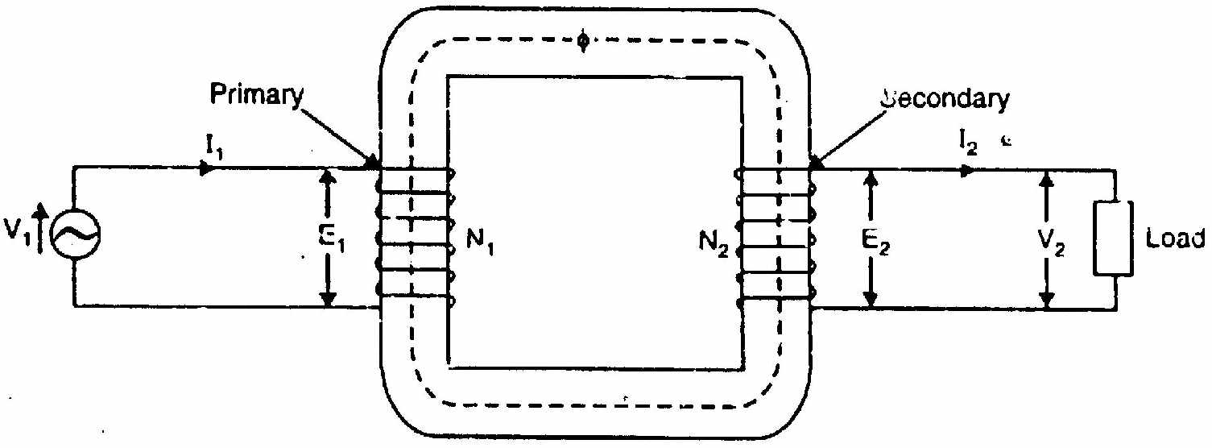

Slide 4
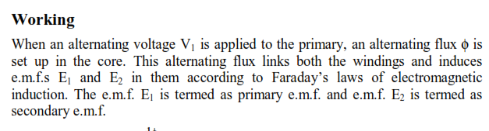
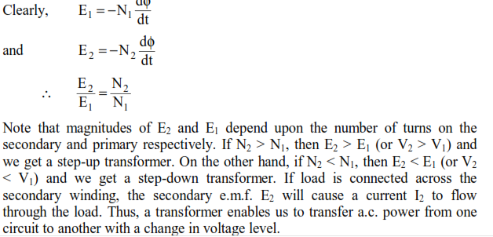

Slide 5
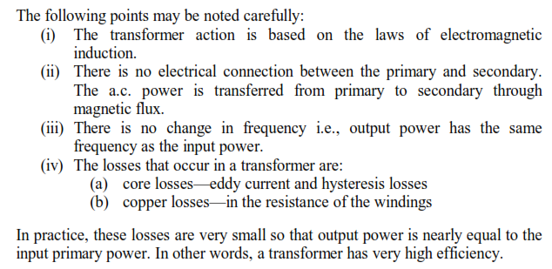
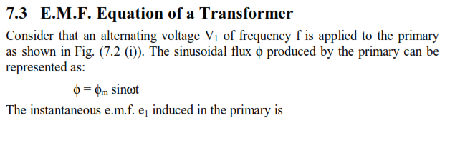

Slide 6

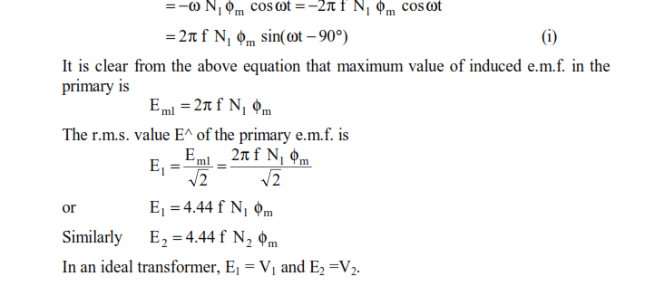

Slide 7
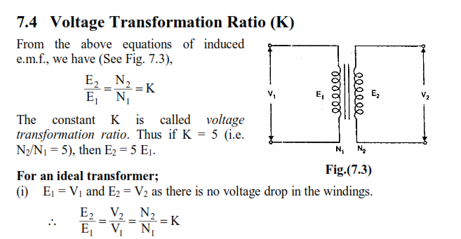

Slide 8
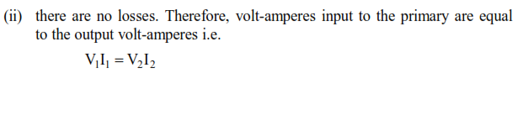
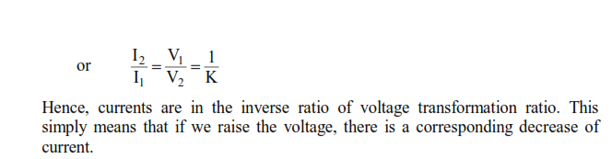

Slide 9
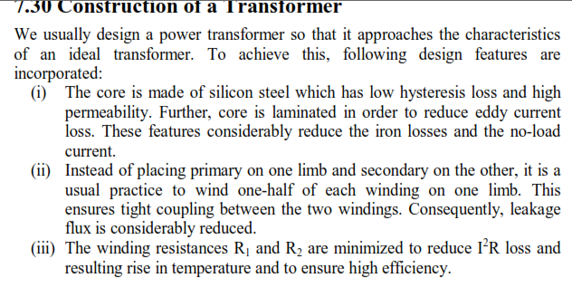

Slide 10
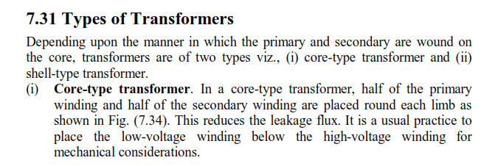
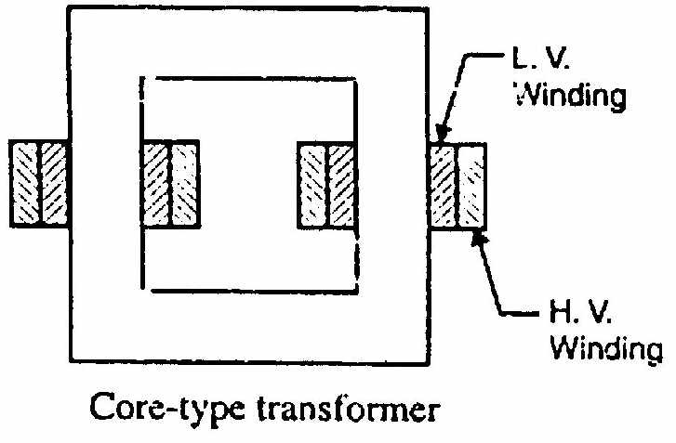

Slide 11
